Slide 1
MOVE UP 2
STARTER UNIT

Slide 3
LET’S CHANT AND POINT

Slide 4
LET’S CHANT AND POINT

Slide 6
LESSON 5:REVIEW

Slide 7
Notes:
Use flashcards for playing this game.
Show a flashcard on the board and draw lines for letters of this word.
Students have to guess what the letters are.
If their guessing is correct, they continue to guess the others.
If their guessing is incorrect, the teacher will draw a part of the hangman picture.
When the hangman picture is completed, students lose the game.
However, students will win the game when they can guess all the letters of that word before the hangman picture drawing is done.

Slide 8
c
o
w
Notes:
Teacher clicks to the red circle if Sts choose the wrong letters.
If correct, click to the squares to show the letters.
Finally, click on the mouse to hear the sound.

Slide 9
b
a
n
a
n
a

Slide 10
j
a
c
k
e
t

Slide 11
l
e
m
o
n

Slide 13
LOOK AND WRITE
Notes:
Show students how to do the task.
Go around for help if necessary.
Check the answers with the whole class.

Slide 14
ax
Notes:
Teacher clicks to hear the sounds.

Slide 15
g
o
o
s
e

Slide 16
h
o
u
s
e

Slide 17
f
a
r
m

Slide 18
k
i
n
g

Slide 19
e
a
g
l
e

Slide 20
g
a
n
i
u
a

Slide 21
n
k
e
y
d
o

Slide 22
Pair work
Notes:
Ask students to work in pairs: point, say and check their answers.
Go around and help students if necessary.

Slide 23
LOOK, CIRCLE AND WRITE.
Notes:
Point to the pictures and ask students to identify them.
Do an example with the whole class.
Ask students to do Exercise 2 individually.

Slide 25
Pair work
Notes:
Read and check their answers.
Go around for help.

Slide 27
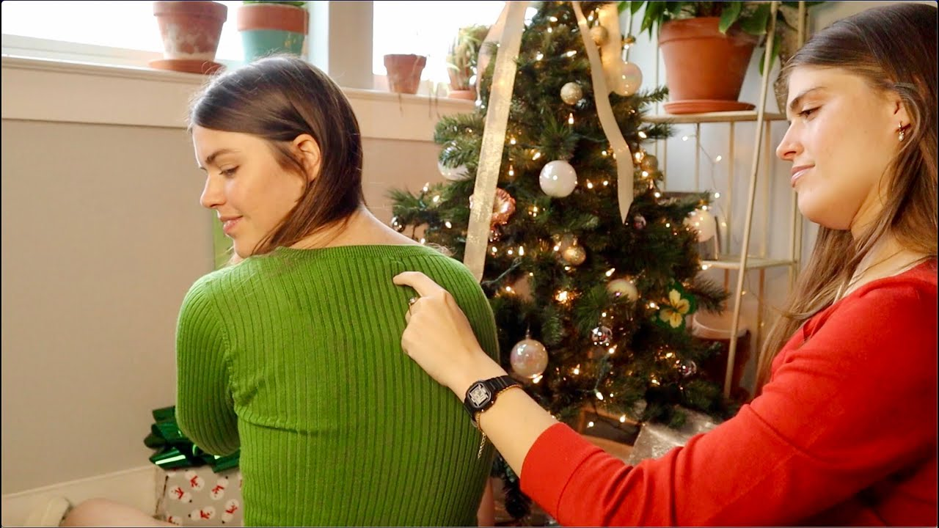
Tracing on the back
Notes:
Tell students the rules of the game.
Split everyone into groups of 7. Each group makes a line.
Ask one volunteer from each group comes up to the front.
Secretly write down a letter on the piece of paper and show the letter to the volunteers. The volunteers are not allowed to speak, say the letter, or give any hints to their friends.
Say “go”, the volunteer traces the letter on the back of their friend using only their finger.
If the last student figures out the letter, he/she must raise his/her hand and share what he/she thinks the letter is. If the letter is correct, the group receives one point. The group with the most points will win the game..

